Slide 1

-ALPS

Slide 2
STEPS TO PREDICTIVE MODELLING
Cleaning
Analyzing
Modelling
Combined Models
Summary

Slide 3
EXPLORATORY DATA ANALYSIS

Slide 4
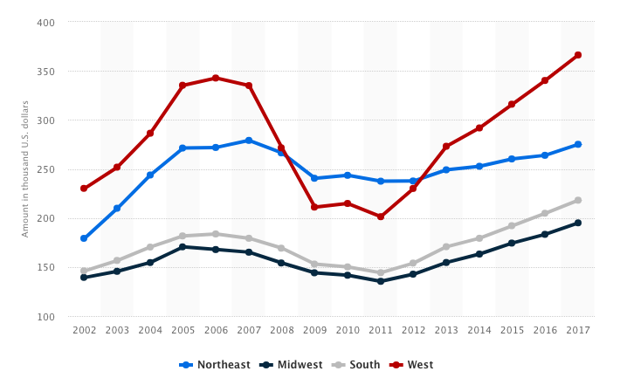
2930 observations taken from 2006-2010
80 variables related to property sales
Kaggle Dataset: 37 as numeric & 43 as object type
Ames Housing Data:
20 continuous variables → dimensions (sqft)
14 discrete variables → quantify items occurring in house
23 nominal variables → identify various types of conditions
23 ordinal variable → rate various items in property

Slide 5
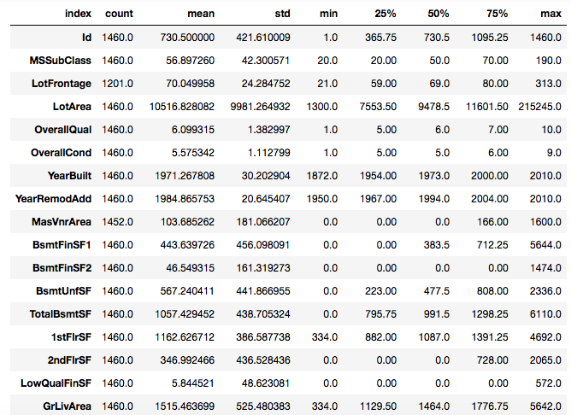
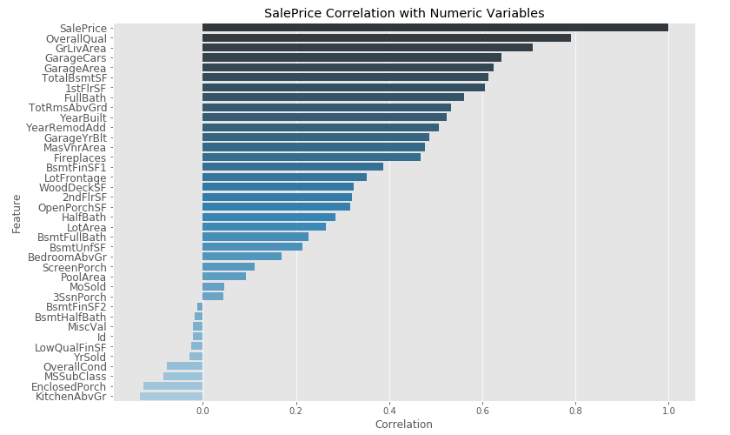

Slide 6
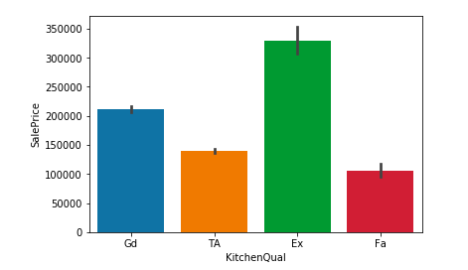
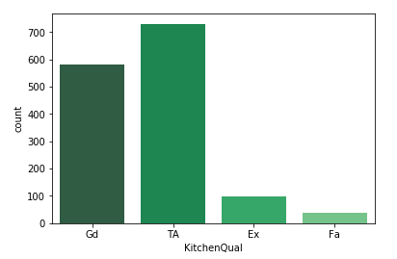
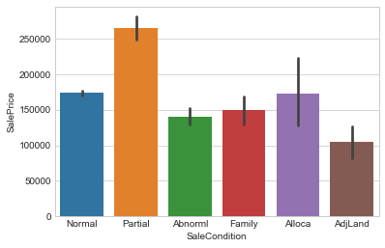
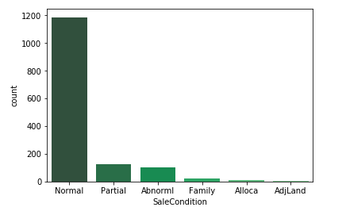

Slide 7
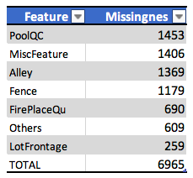
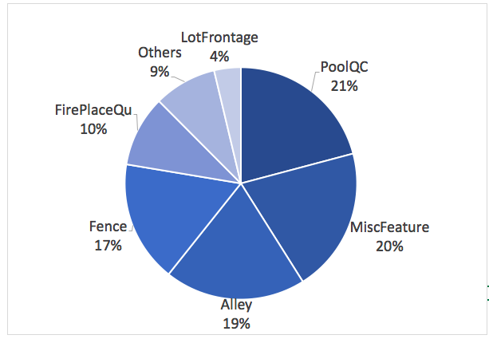
Missingness

Slide 8
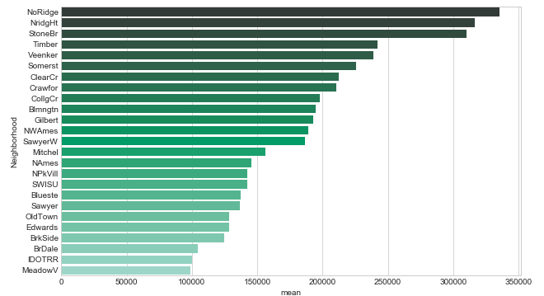
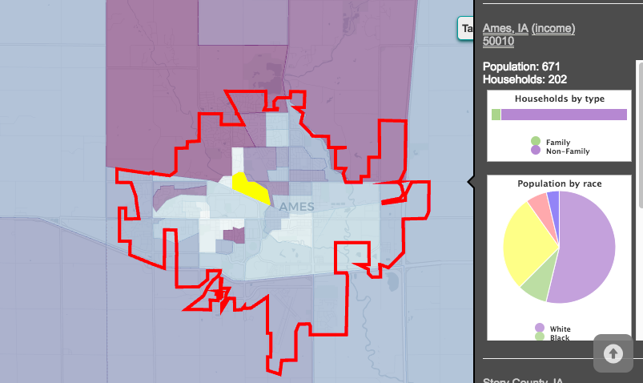
Feature Engineering

Slide 9
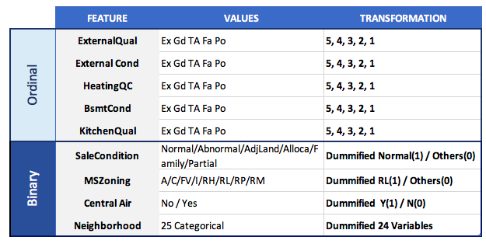
Total of 9 variables were transformed
Ordinal Variables were later on combined
Neighborhood ”dummified” substantially increased number of features

Slide 10
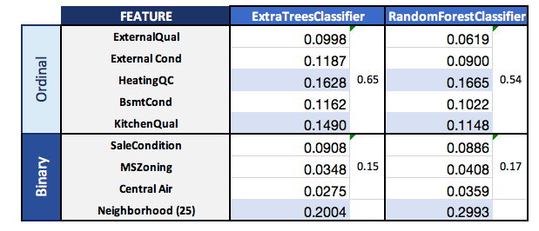
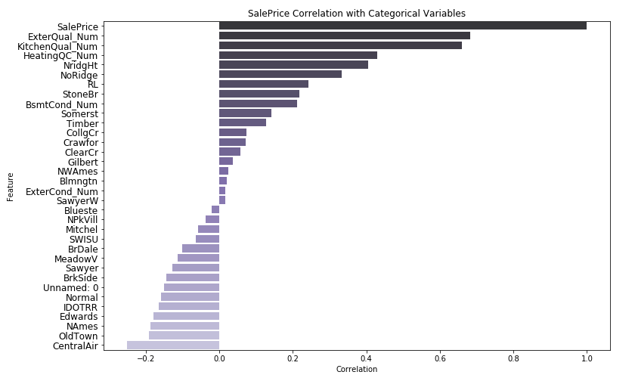
Random Forest and Correlations

Slide 11
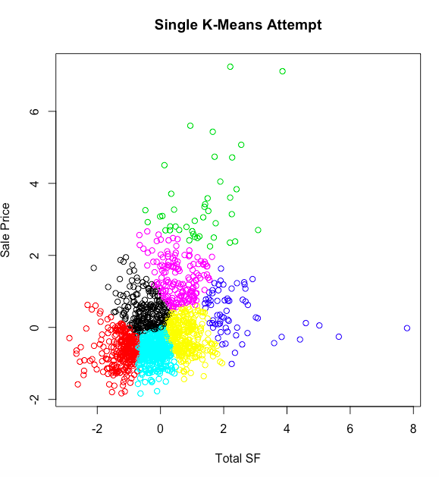
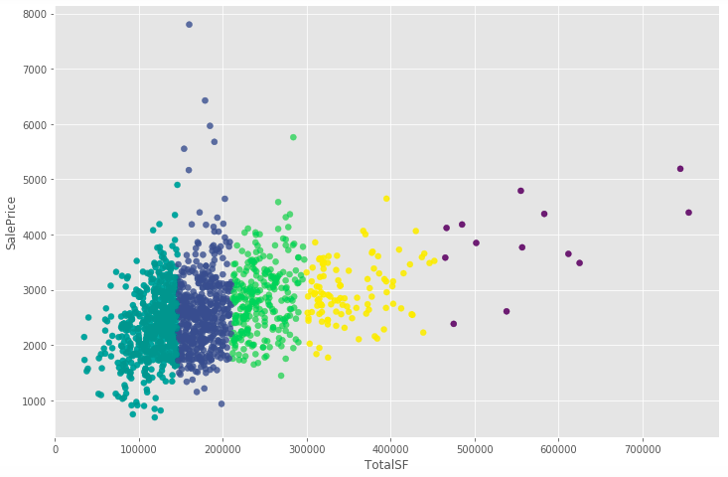
Total SF Cluster Analysis
Kmean Cluster

Slide 12
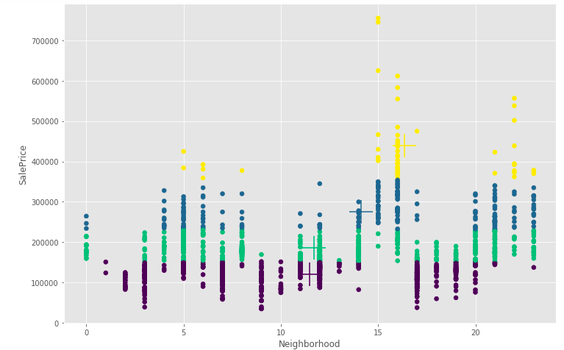
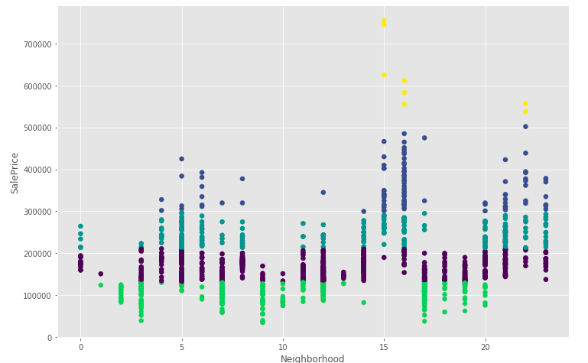
Neighborhoods Cluster Analysis
Kmean Cluster
Hierarchical Cluster

Slide 13
MODELLING

Slide 14
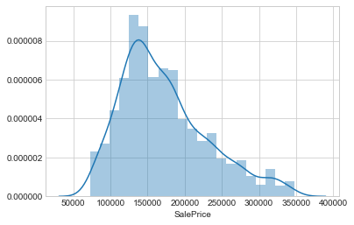
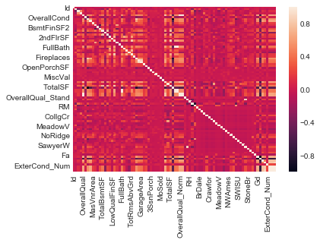

Slide 15
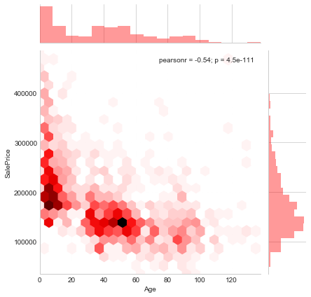

Slide 16
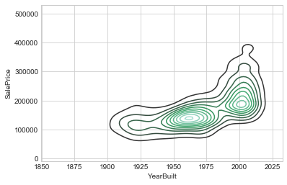
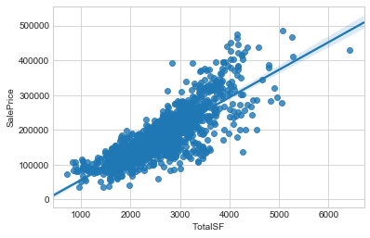

Slide 17
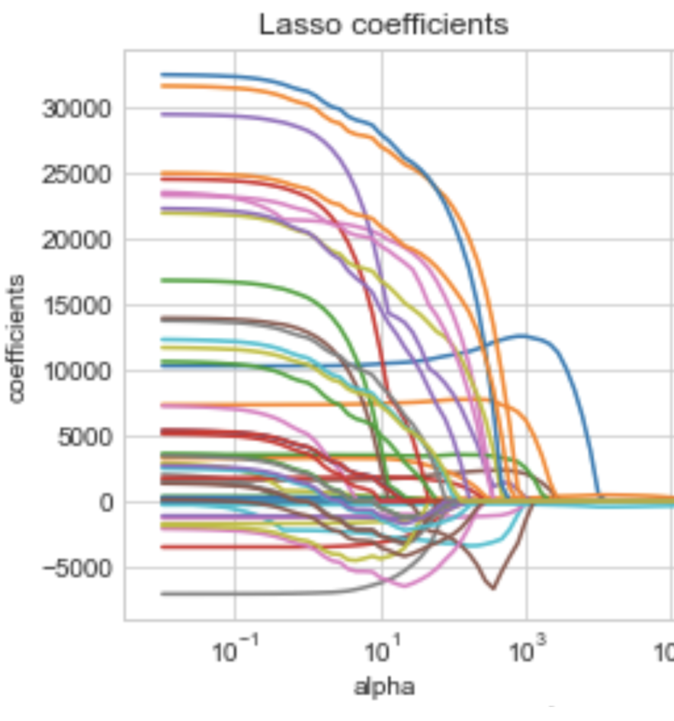
MODEL TUNING
Alpha was chosen at 10 after testing 10000 times for the best alpha.
After 10000 tests, Lasso Regression performed better than Ridge Regression.
For Cross-Validation we did a train-test split at 80/20
We found cv = 10 to give the best accuracy score.

Slide 18
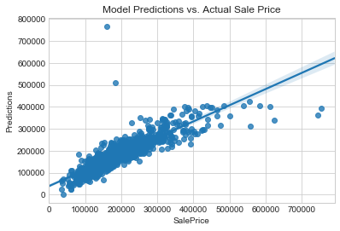
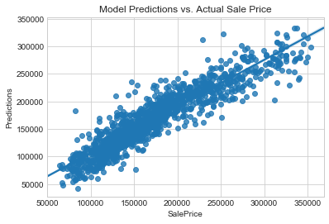
Outliers were removed at extreme values.
Sale Prices over $355,000 and under $63,000 were removed.
-After removing outliers, the Lasso Score improved by 9.0%
-The final R score improved by 10.5% after Cross-Validation.

Slide 19
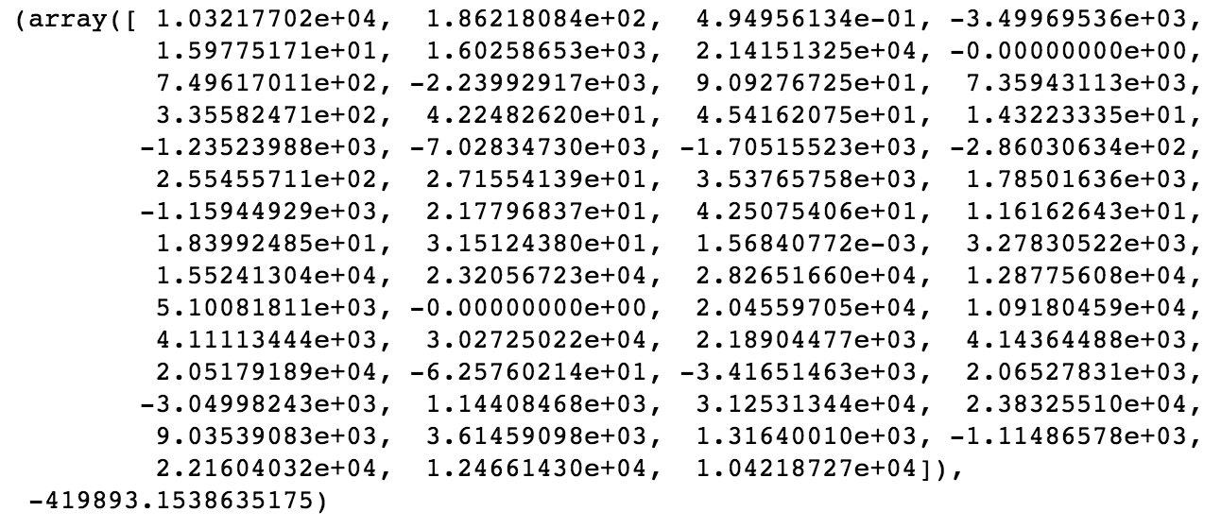
Model Results
Kaggle score: 0.15153
30% increase in error when simplifying to 6 variables:
OverallQual, TotalSF, Condion_W_Avg, FullBath_Norm, Age, GarageArea
We use 59 variables for the Lasso final model (large number in part because of dummy variables)

Slide 20
CONCLUSIONS

Slide 21
Complexity of model translates into more accurate predictions; however a more simplistic model could be considered for practical use (trade off in lower accuracy).
Model could improve if neighborhoods are standardized to US census track for more demographic information such as household income.
Dataset could be complemented with other variables such as crime, school, transportation that seem to be important in house hunting/buying.
If would be important to validate model with more recent data (years) as real estate seem cyclical with ups/downs

Slide 22
Household of Ames Versus Income Comparison

Slide 23
Transportation of Ames Versus Income Comparison

